Slide 1

Code Refactoring and Bug Fixing

Slide 2
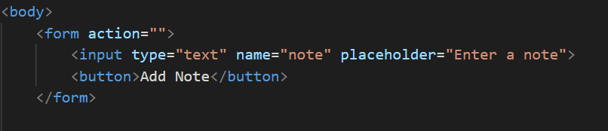
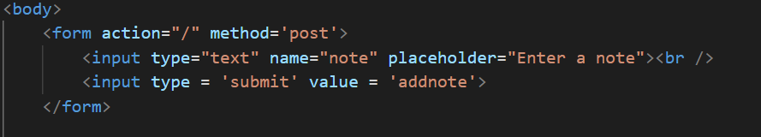
Original issue:
Route is not called
Method is not declared
Add button to append the notes
Solution:
Route is declared
Post method is used to update the resource
Button is placed to append the values

Slide 3
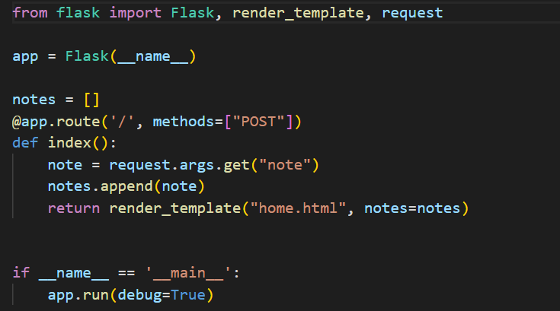
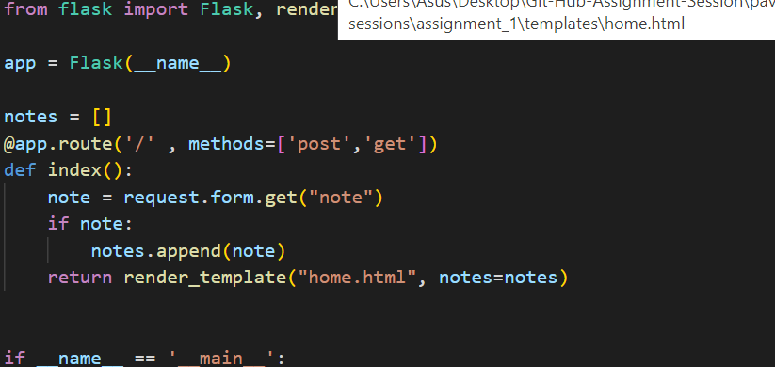
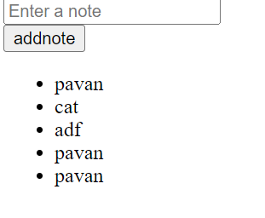
Request.args.get accesses the query string and returns key value pairs
Request.forms.get access the form and returns the form parameters
If statement is used to check note variable contains any value or not

